Slide 1
Sisteme Tolerante la Defecte Introducere MPI
Lect. Dr. Ing. Cristian Chilipirea – cristian.chilipirea@mta.ro

Slide 2
MPI
Framework care facilitează
Pornirea programelor distribuite (procese pe același sistem sau pe sisteme diferite, dar strâns conectate – ideal aceeași rețea)
Conectarea proceselor unui program distribuit (accept, bind, connect)
Simplificarea identificării (identificatori în loc de IP, port)
Simplificarea comunicării (oferă funcții gen Send/Recv, Broadcast)
Asigură comunicarea corectă pe sisteme cu arhitecturi de calcul diferite (little/big endian problems)

Slide 3
MPI memoria
Nu avem memorie partajată în MPI. Arhitectură NUMA
Toate variabilele sunt locale proceselor.
Pentru a muta informație de la un proces la altul vor trebuie folosită comunicație, prin apelul funcțiilor oferite de MPI:
Send/Recv
Broadcast
Scatter
Gather

Slide 4
Instalare OpenMPI
apt-get install libopenmpi-dev openmpi-bin openmpi-doc openmpi-common

Slide 5
Compiling and running MPI programs
mpicc test.c
mpirun –np 4 a.out
mpirun –np 3 date
./a.out
Pornește 4 procese.
Dacă este setat, va porni procesele pe mașini diferite.
Procesele sunt identice dar au id-uri diferite.
Funcționează parțial și cu programe care nu sunt implementate pentru MPI.
Funcționează dar pornește un singur proces.

Slide 6
MPI example
#include<mpi.h>
#include<stdio.h>
int main(int argc, char * argv[])
{
int rank;
int nProcesses;
MPI_Init(&argc, &argv);
MPI_Comm_rank(MPI_COMM_WORLD, &rank);
MPI_Comm_size(MPI_COMM_WORLD, &nProcesses);
printf("Hello from %i/%i\n", rank, nProcesses);
MPI_Finalize();
return 0;
}

Slide 7
MPI example
#include<mpi.h>
#include<stdio.h>
int main(int argc, char * argv[])
{
int rank;
int nProcesses;
MPI_Init(&argc, &argv);
MPI_Comm_rank(MPI_COMM_WORLD, &rank);
MPI_Comm_size(MPI_COMM_WORLD, &nProcesses);
printf("Hello from %i/%i\n", rank, nProcesses);
MPI_Finalize();
return 0;
}
Pornește procesele MPI

Slide 8
MPI example
#include<mpi.h>
#include<stdio.h>
int main(int argc, char * argv[])
{
int rank;
int nProcesses;
MPI_Init(&argc, &argv);
MPI_Comm_rank(MPI_COMM_WORLD, &rank);
MPI_Comm_size(MPI_COMM_WORLD, &nProcesses);
printf("Hello from %i/%i\n", rank, nProcesses);
MPI_Finalize();
return 0;
}
Întoarce ID-ul procesului (rank-ul)

Slide 9
MPI example
#include<mpi.h>
#include<stdio.h>
int main(int argc, char * argv[])
{
int rank;
int nProcesses;
MPI_Init(&argc, &argv);
MPI_Comm_rank(MPI_COMM_WORLD, &rank);
MPI_Comm_size(MPI_COMM_WORLD, &nProcesses);
printf("Hello from %i/%i\n", rank, nProcesses);
MPI_Finalize();
return 0;
}
Întoarce numărul total de procese

Slide 10
MPI example
#include<mpi.h>
#include<stdio.h>
int main(int argc, char * argv[])
{
int rank;
int nProcesses;
MPI_Init(&argc, &argv);
MPI_Comm_rank(MPI_COMM_WORLD, &rank);
MPI_Comm_size(MPI_COMM_WORLD, &nProcesses);
printf("Hello from %i/%i\n", rank, nProcesses);
MPI_Finalize();
return 0;
}
Afișează hello (pentru fiecare proces pornit).

Slide 11
MPI example
#include<mpi.h>
#include<stdio.h>
int main(int argc, char * argv[])
{
int rank;
int nProcesses;
MPI_Init(&argc, &argv);
MPI_Comm_rank(MPI_COMM_WORLD, &rank);
MPI_Comm_size(MPI_COMM_WORLD, &nProcesses);
printf("Hello from %i/%i\n", rank, nProcesses);
MPI_Finalize();
return 0;
}
Oprește programul MPI.

Slide 12
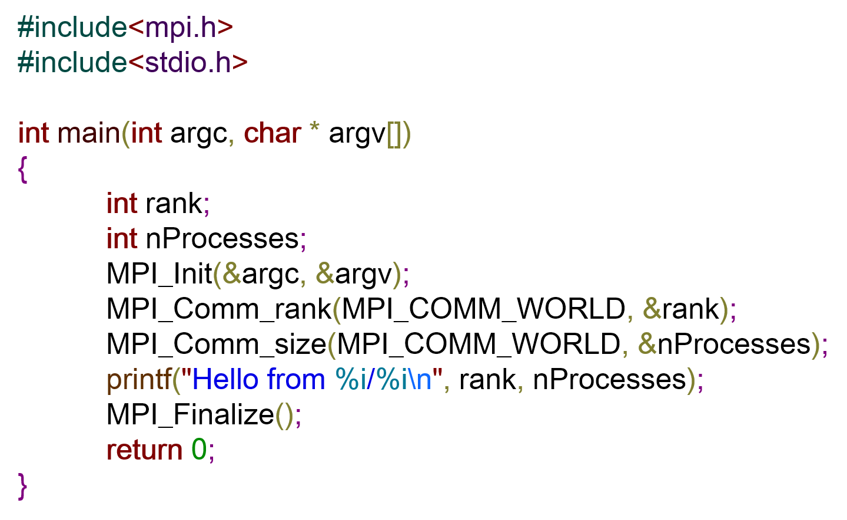
MPI example executed
Hello from 0/4
Hello from 3/4
Hello from 2/4
Hello from 1/4

Slide 14
MPI_Send/MPI_Recv
int MPI_Send( ↓ void *b, ↓ int c, ↓ MPI_Datatype d, ↓ int reciever, ↓ int t, ↓ MPI_Comm)
v
&v[3]
&a
v+5
num_el(v)
[0,..)
[ 0, num_tasks )
MPI_COMM_WORLD
MPI_INT
MPI_CHAR
MPI_FLOAT
MPI_LONG
[ 0, .. )

Slide 15
MPI_Send/MPI_Recv
int MPI_Recv( ↑ void *b, ↓ int c, ↓ MPI_Datatype d, ↓ int sender, ↓ int t, ↓ MPI_Comm, ↑ MPI_Status * )
v
&v[3]
&a
v+5
[ 0, .. )
MPI_ANY_TAG
num_el(v)
[0,..)
[ 0, num_tasks )
MPI_ANY_SOURCE
MPI_INT
MPI_CHAR
MPI_FLOAT
MPI_LONG
MPI_COMM_WORLD
&Stat
MPI_STATUS_IGNORE
Stat.MPI_SOURCE, Stat.MPI_TAG

Slide 16
MPI_Bcast
int MPI_Bcast ( ↕ void *b, ↓ int c, ↓ MPI_Datatype d, ↓ int root, ↓ MPI_Comm )
num_el(v)
[0,..)
v
&v[3]
&a
v+5
[ 0, num_tasks )
MPI_INT
MPI_CHAR
MPI_FLOAT
MPI_LONG
MPI_COMM_WORLD

Slide 17
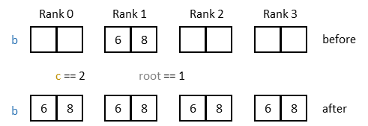
MPI_Bcast

Slide 18
MPI_Scatter
int MPI_Scatter ( ↓ void *sb, ↓ int sc, ↓ MPI_Datatype sd, ↑ void *rb, ↓ int rc, ↓ MPI_Datatype rd, ↓ int root, ↓ MPI_Comm )
[ 0, num_tasks )
num_el(v)/num_tasks
[0,..)
num_el(v)/num_tasks
[0,..)
v
&v[3]
&a
v+5
v
&v[3]
&a
v+5
MPI_INT
MPI_CHAR
MPI_FLOAT
MPI_LONG
MPI_INT
MPI_CHAR
MPI_FLOAT
MPI_LONG
MPI_COMM_WORLD

Slide 19
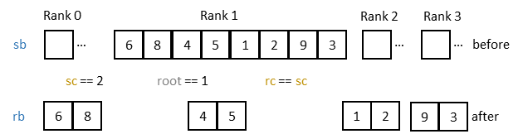
MPI_Scatter

Slide 20
MPI_Gather
int MPI_Gather ( ↓ void *sb, ↓ int sc, ↓ MPI_Datatype sd, ↑ void *rb, ↓ int rc, ↓ MPI_Datatype rd, ↓ int root, ↓ MPI_Comm )
num_el(v)/num_tasks
[0,..)
num_el(v)/num_tasks
[0,..)
[ 0, num_tasks )
v
&v[3]
&a
v+5
v
&v[3]
&a
v+5
MPI_INT
MPI_CHAR
MPI_FLOAT
MPI_LONG
MPI_INT
MPI_CHAR
MPI_FLOAT
MPI_LONG
MPI_COMM_WORLD

Slide 21
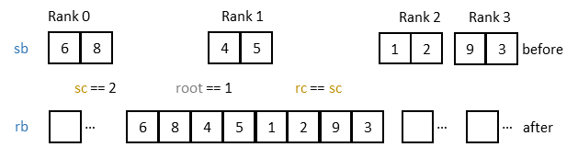
MPI_Gather

Slide 23
MPI blocking/non-blocking send/recv
Proces 1
Proces 2
MPI_Send()
MPI_Recv()

Slide 24
MPI blocking/non-blocking send/recv
Proces 1
Proces 2
MPI_Send()
MPI_Recv()
MPI/Kernel Buffer
MPI/Kernel Buffer
Network

Slide 25
MPI blocking recv/non-blocking send
Proces 1
Proces 2
Program counter
MPI_Send()
MPI_Recv()
MPI/Kernel Buffer
MPI/Kernel Buffer
Network

Slide 26

MPI blocking recv/non-blocking send
Proces 1
Proces 2
MPI_Send()
MPI_Recv()
MPI/Kernel Buffer
MPI/Kernel Buffer
Network

Slide 27
MPI blocking recv/non-blocking send
Proces 1
Proces 2
MPI_Send()
MPI_Recv()
MPI/Kernel Buffer
MPI/Kernel Buffer
Network

Slide 28
MPI blocking recv/non-blocking send
Proces 1
Proces 2
MPI_Send()
MPI_Recv()
MPI/Kernel Buffer
MPI/Kernel Buffer
Network

Slide 29
MPI blocking recv/non-blocking send
Proces 1
Proces 2
MPI_Send()
MPI_Recv()
MPI/Kernel Buffer
MPI/Kernel Buffer
Network

Slide 30
MPI blocking recv/non-blocking send
Proces 1
Proces 2
MPI_Send()
MPI_Recv()
MPI/Kernel Buffer
MPI/Kernel Buffer
Network

Slide 31
MPI blocking recv/non-blocking send
Proces 1
Proces 2
MPI_Send()
MPI_Recv()
MPI/Kernel Buffer
MPI/Kernel Buffer
Network

Slide 32
MPI blocking recv/blocking send
Proces 1
Proces 2
MPI_Send()
MPI_Send() poate bloca dacă buffer-ul local este plin.
MPI/Kernel Buffer
Network

Slide 33
MPI blocking recv/blocking send
Proces 1
Proces 2
MPI_Send()
MPI_Recv()
MPI/Kernel Buffer
MPI/Kernel Buffer
Network

Slide 34
MPI blocking recv/blocking send
Proces 1
Proces 2
MPI_Send()
MPI_Recv()
MPI/Kernel Buffer
MPI/Kernel Buffer
Network

Slide 35
MPI blocking recv/synchronized send

Slide 36
MPI blocking recv/synchronized send
Proces 1
Proces 2
MPI_Ssend()
MPI_Recv()
MPI/Kernel Buffer
MPI/Kernel Buffer
Network

Slide 37
MPI blocking recv/synchronized send
Proces 1
Proces 2
MPI_Ssend()
MPI_Recv()
MPI/Kernel Buffer
MPI/Kernel Buffer
Network

Slide 38
MPI blocking recv/synchronized send
Proces 1
Proces 2
MPI_Ssend()
MPI_Recv()
MPI/Kernel Buffer
MPI/Kernel Buffer
Network

Slide 39
MPI blocking recv/synchronized send
Proces 1
Proces 2
MPI_Ssend()
MPI_Recv()
MPI/Kernel Buffer
MPI/Kernel Buffer
Network

Slide 40
MPI blocking recv/synchronized send
Proces 1
Proces 2
MPI_Ssend()
MPI_Recv()
MPI/Kernel Buffer
MPI/Kernel Buffer
Network

Slide 41
MPI blocking recv/synchronized send
Proces 1
Proces 2
MPI_Ssend()
MPI_Recv()
Got it!
MPI/Kernel Buffer
MPI/Kernel Buffer
Network

Slide 42
MPI blocking recv/synchronized send
Proces 1
Proces 2
MPI_Ssend()
MPI_Recv()
MPI/Kernel Buffer
MPI/Kernel Buffer
Got it!
Network

Slide 43
MPI blocking recv/synchronized send
Proces 1
Proces 2
MPI_Ssend()
MPI_Recv()
MPI/Kernel Buffer
MPI/Kernel Buffer
Got it!
Network

Slide 44
MPI blocking recv/synchronized send
Proces 1
Proces 2
MPI_Ssend()
MPI_Recv()
Got it!
MPI/Kernel Buffer
MPI/Kernel Buffer
Network

Slide 45
MPI blocking recv/synchronized send
Proces 1
Proces 2
Got it!
MPI_Ssend()
MPI_Recv()
MPI/Kernel Buffer
MPI/Kernel Buffer
Network

Slide 46
MPI non-blocking recv/non-blocking send

Slide 47
MPI non-blocking recv/non-blocking send
Proces 1
Proces 2
MPI_Test()
returns
0
MPI_Test()
returns
0
MPI_Isend()
MPI_Irecv()
MPI/Kernel Buffer
MPI/Kernel Buffer
Network

Slide 48
MPI non-blocking recv/non-blocking send
Proces 1
Proces 2
MPI_Test()
returns
0
MPI_Test()
returns
0
MPI_Isend()
MPI_Irecv()
MPI/Kernel Buffer
MPI/Kernel Buffer
Network

Slide 49
MPI non-blocking recv/non-blocking send
Proces 1
Proces 2
MPI_Test()
returns
0
MPI_Test()
returns
0
MPI_Isend()
MPI_Irecv()
MPI/Kernel Buffer
MPI/Kernel Buffer
Network

Slide 50
MPI non-blocking recv/non-blocking send
Proces 1
Proces 2
MPI_Test()
returns
1
MPI_Test()
returns
0
MPI_Isend()
MPI_Irecv()
MPI/Kernel Buffer
MPI/Kernel Buffer
Network

Slide 51
MPI non-blocking recv/non-blocking send
Proces 1
Proces 2
MPI_Test()
returns
1
MPI_Test()
returns
0
MPI_Isend()
MPI_Irecv()
MPI/Kernel Buffer
MPI/Kernel Buffer
Network

Slide 52
MPI non-blocking recv/non-blocking send
Proces 1
Proces 2
MPI_Test()
returns
1
MPI_Test()
returns
0
MPI_Isend()
MPI_Irecv()
MPI/Kernel Buffer
MPI/Kernel Buffer
Network

Slide 53
MPI non-blocking recv/non-blocking send
Proces 1
Proces 2
MPI_Test()
returns
1
MPI_Test()
returns
1
MPI_Isend()
MPI_Irecv()
MPI/Kernel Buffer
MPI/Kernel Buffer
Network

Slide 54
Comunicația non-blocantă
int MPI_Isend( ↓ void *b, ↓ int c, ↓ MPI_Datatype d, ↓ int recv, ↓ int t, ↓ MPI_Comm, ↑ MPI_Request *)
int MPI_Recv( ↑ void *b, ↓ int c, ↓ MPI_Datatype d, ↓ int sender, ↓ int t, ↓ MPI_Comm, ↑ MPI_Request * )
MPI_Test(↓ MPI_Request *, ↑ int * flag, ↑ MPI_Status *)
MPI_Testall()
MPI_Testany()
MPI_Testsome()
MPI_Wait(↓ MPI_Request *, ↑ MPI_Status *)
MPI_Waitall()
MPI_Waitany()
MPI_Waitsome()

Slide 56
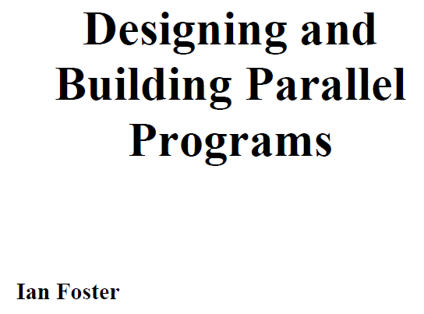

Modelul Foster

Slide 57
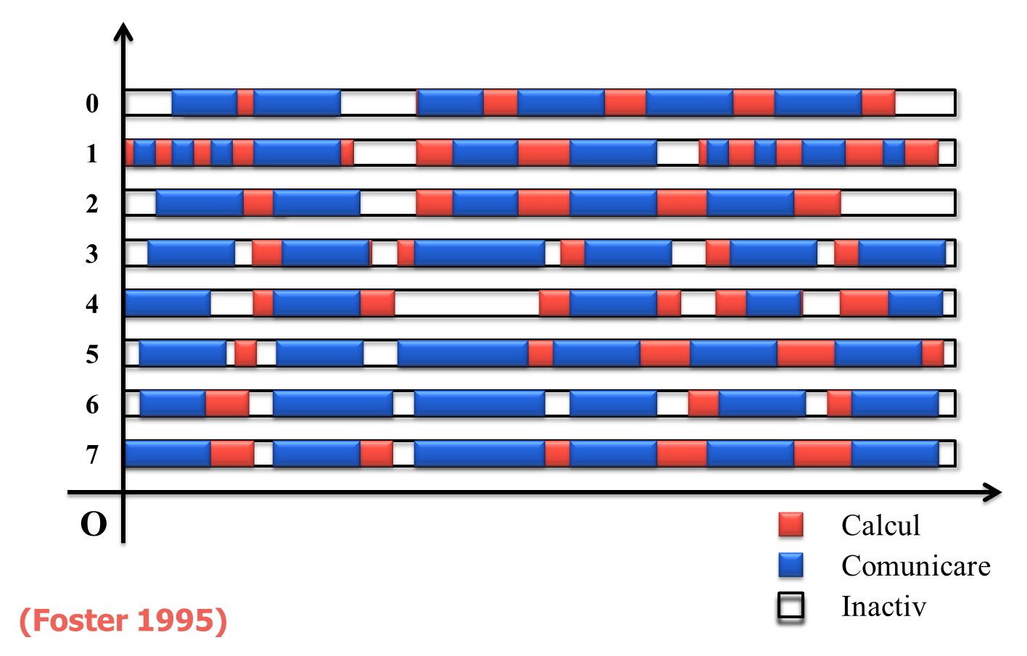
Modelul Foster

Slide 58
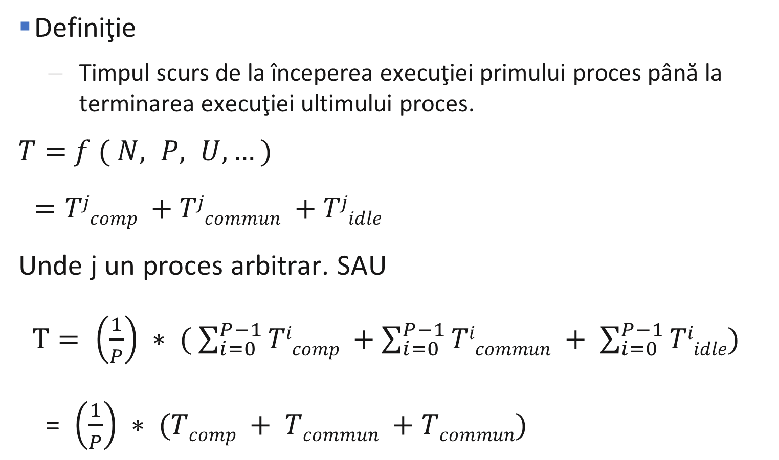
Modelul Foster
Definiţie
Timpul scurs de la începerea execuţiei primului proces până la terminarea execuţiei ultimului proces.
$T=$ $f ( N, P, U, …)$
$=Tjcomp +Tjcommun +Tjidle$
Unde j un proces arbitrar. SAU
$T= \left(\frac{1}{P}\right) ∗ ( \sum_{i=0}^{P−1}{Ticomp} +\sum_{i=0}^{P−1}{Ticommun} + \sum_{i=0}^{P−1}{Tiidle})$
= $\left(\frac{1}{P}\right) ∗ (Tcomp + Tcommun +Tcommun)$

Slide 59

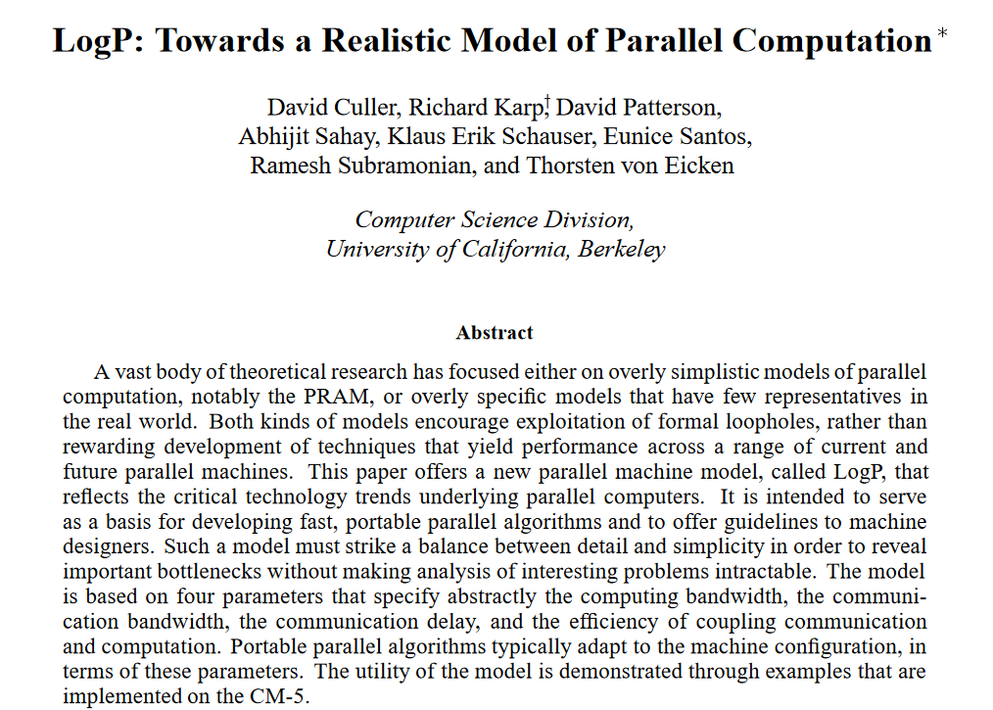

LogP model
David Culler
David Patterson

Slide 60
LogP model
L – Limita superioară a latenței (latency) sau întârzierea de transmitere a unui mesaj de la sursă la destinație
o - overhead, durata de timp în care procesorul execută transmiterea sau recepţia fiecărui mesaj; În acest timp procesorul nu poate efectua alte operații
g - gap, intervalul minim de timp între două transmiteri succesive sau două recepţii succesive la acelaşi procesor. Reciproca lui g este echibalentă cu lungimea de bandă (bandwidth)
P - numărul de module procesor / memorie. Presupunem că funcționează la aceeași unitate de timp, numită ciclu.

